Slide 1

Understanding File-Based Student Management in C
A comprehensive guide to building a role-based student management system using file I/O operations, authentication mechanisms, and structured data handling in C programming.

Slide 2
What We'll Cover
01
02
03
Header Files & Setup
Authentication System
CRUD Operations
Essential libraries and constants for file operations
User login and role-based access control
Create, read, update, and delete student records
04
05
Role-Based Menus
Program Flow
Different access levels for admin, staff, and guests
How everything connects in the main function

Slide 3
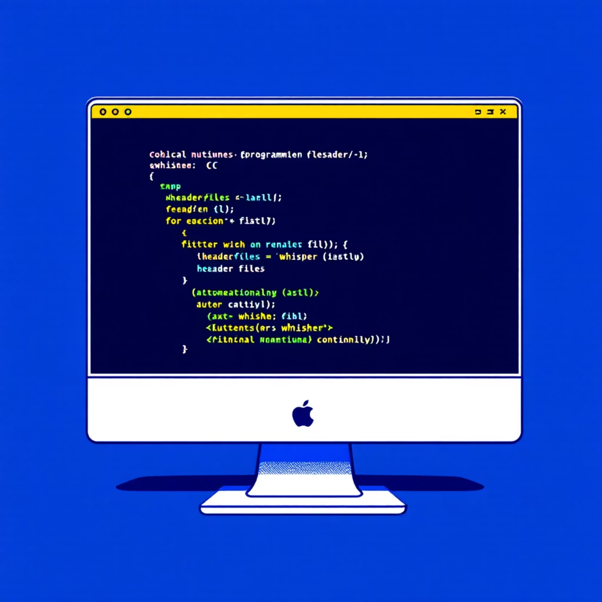
Foundation: Header Files & Constants
Essential Libraries
The program relies on three standard C libraries that provide core functionality:
stdio.h: Handles all input/output operations including file reading, writing, and console interaction
stdlib.h: Provides memory allocation functions and process control utilities
string.h: Offers string manipulation functions like strcmp() and strcpy()
File Path Constants
Two preprocessor directives define file locations:
STUD_FILE: Points to students.txt where all student records are stored
CRE_FILE: Points to credentials.txt containing user authentication data

Slide 4





User Authentication: The Login Function
Prompt User
Collects username and password from the console
Open Credentials File
Reads credentials.txt to access stored user data
Validate Input
Compares entered credentials with file records
Set User Context
Assigns currentUser and currentRole on successful match
Return Status
Returns 1 for success or 0 for authentication failure
This function serves as the security gateway, ensuring only authorized users can access the system with appropriate permission levels.

Slide 5


Core CRUD Operations
Add Student
Display Students
Search Student
Prompts for roll number, name, and mark, then appends the new record to students.txt in append mode, confirming successful addition.
Opens students.txt in read mode, prints a formatted header, then iterates through and displays each student record before closing the file.
Prompts for a roll number, opens the file in read mode, searches for matching records, and displays results or a not found message.

Slide 6

Advanced File Operations
Delete Student Function
Update Student Function
Removing records requires careful file manipulation:
Modifying existing records follows a similar pattern:
Prompt user for the roll number to delete
Prompt for the roll number to update
Create a temporary file to store remaining records
Create a temporary file for modified data
Copy all records except the target deletion
Copy all records, updating the matching entry
Replace the original file with the temporary one
Replace original file with updated version
This approach ensures data integrity by avoiding direct file modification.
The temporary file technique prevents data corruption during updates.

Slide 7
Role-Based Access Control
Guest Menu
Limited read-only access: display and search students only
Staff Menu
Enhanced privileges: add, display, search, and update student records
Admin Menu
Complete control: full access to all operations including delete functionality
Three distinct menu functions enforce access control based on user roles. Each menu presents only the operations permitted for that role, ensuring secure and appropriate system usage.

Slide 8
Program Flow: The Main Function
Authentication
1
Calls the login function to verify user credentials and establish identity
2
Role Assignment
Displays user information and confirms the assigned role level
Menu Display
3
Routes to appropriate menu function based on authenticated user's role
4
Operation Loop
Allows continuous operations until user chooses to exit the system
Clean Exit
5
Returns 0 to indicate successful program termination

Slide 9
Key Programming Concepts
File I/O Operations
String Handling
Using fopen(), fclose(), fprintf(), and fscanf() to manage persistent data storage in text files.
Leveraging strcmp() for authentication and string manipulation for data processing.
Temporary Files
Structured Programming
Creating intermediate files for safe delete and update operations without data loss.
Breaking complex tasks into discrete functions with clear, single responsibilities.
Access Control
Data Persistence
Implementing role-based permissions to restrict functionality based on user privileges.
Storing records in text files to maintain information between program executions.

Slide 10

Key Takeaways
Modular Design Matters
Breaking the program into focused functions improves readability, maintainability, and debugging.
File Operations Are Powerful
Text files provide simple yet effective persistent storage for small to medium-sized datasets.
Security Through Roles
Role-based access control protects sensitive operations while providing appropriate functionality to each user type.
This student management system demonstrates fundamental C programming concepts that form the foundation for more complex applications. Practice these techniques to build robust, maintainable software.

